Slide 1
Rerun the experiment without memory
Record the result of model with initial parameters
Partition the dataset into two datasets D1, D2 by sampling two data points from every 2/4/8/16/32 data points
Divide the dataset into m t-batch, for each epoch, randomly sampled k = {1,2,4,8}
t-batch

Slide 2
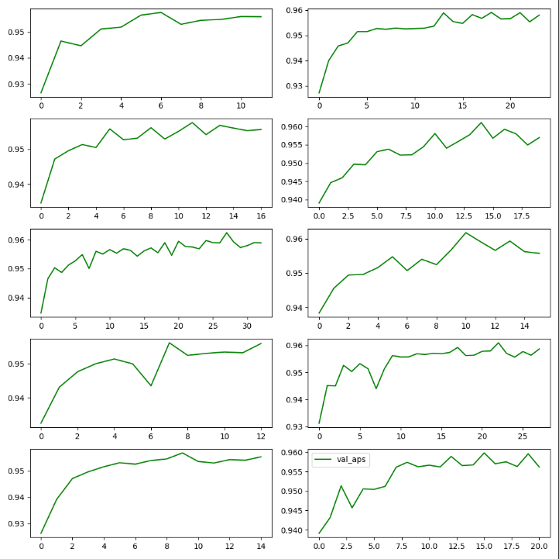
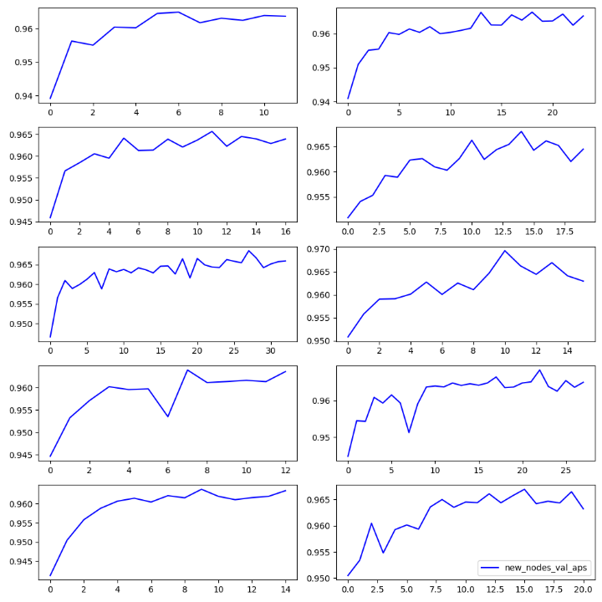
model | Test AP (Transductive) | Test AP (Inductive)
TGN (w/ memory) | 0.9846 | 0.9781
TGN (w/o memory) | 0.9479 | 0.9468
TGN (zero-shot) | 0.6337 | 0.6408

Slide 3
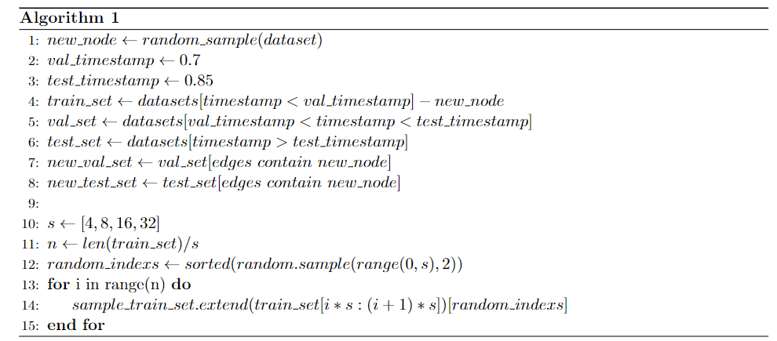
Partition the dataset into two datasets D1, D2 by sampling two data points from every 2/4/8/16/32 data points

Slide 4
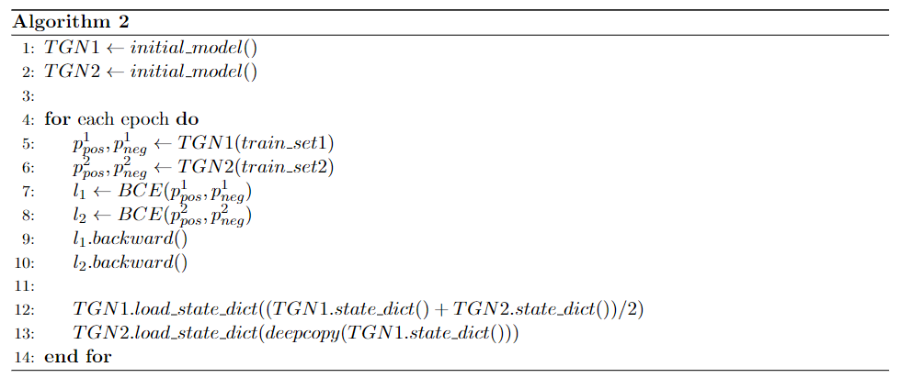
Rerun the training and average the parameters of M1 and M2 for every iteration, record the performance of resulting model

Slide 5
Sample | Test AP (Transductive) | Test AP (Inductive)
4(0) | 0.9419 | 0.9417
4(1) | 0.9415 | 0.9411
4(average) | 0.9167 | 0.9163
4(combine) | 0.9477 | 0.9474
8(0) | 0.9395 | 0.9384
8(1) | 0.9371 | 0.9359
8(average) | 0.9277 | 0.9260
8(combine) | 0.9432 | 0.9429
16(0) | 0.9244 | 0.9235
16(2) | 0.9183 | 0.9181
16(average) | 0.9214 | 0.9194
16(combine) | 0.9161 | 0.9152
32(0) | 0.9024 | 0.8997
32(1) | 0.9024 | 0.8946
32(average) | 0.9047 | 0.9011
32(combine) | 0.9181 | 0.9162

Slide 6
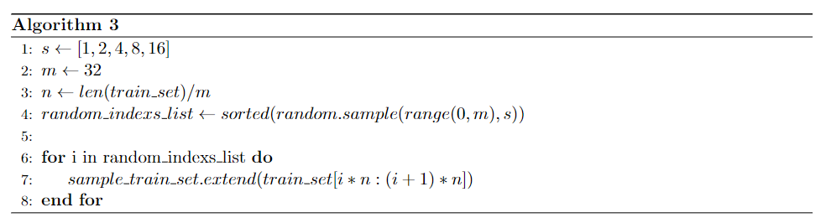
Divide the dataset into m t-batch, for each epoch, randomly sampled k = {1,2,4,8} t-batch

Slide 7
Divide the dataset into m t-batch, for each epoch, randomly sampled k = {1,2,4,8} t-batch
Sample | Test AP (Transductive) | Test AP (Inductive) | Time
1 | 0.9286 | 0.9272 | 0.2523
2 | 0.9200 | 0.9197 | 0.4866
4 | 0.9211 | 0.9186 | 1.0660
8 | 0.9362 | 0.9335 | 1.9456
16 | 0.9465 | 0.9461 | 3.6586

